Slide 1

Operation Analytics and Investigating Metric Spike
Project no:3
trainity
Shubham Tilekar

Slide 2

Description:
In this project, I assume the role of a Lead Data Analyst at a company akin to Microsoft, tasked with conducting Operational Analytics to enhance overall efficiency and performance. The primary objective is to analyze end-to-end operations data, collaborate with various departments, and investigate metric spikes to provide actionable insights. The project revolves around leveraging advanced SQL skills, data collaboration, and effective communication to drive continuous improvement within the organization.

Slide 3
Approach
Data Understanding: Explore datasets, identify key variables.
Collaboration: Work closely with teams for specific data needs.
SQL Analysis: Develop advanced queries, prioritize key metrics.
Metric Spikes: Investigate using SQL, employ statistical methods.
KPI Analysis: Extract and analyze KPIs using SQL.
Iterative Process: Refine queries based on findings, incorporate feedback.
Insight Generation: Derive actionable insights, present with a clear narrative.
Documentation: Document queries and methodologies for transparency.

Slide 4
Tech-Stack:
Tech stack used included MySQL Workbench v8.0.30.0 MySQL Workbench is a graphical tool for working with MySQL servers and databases

Slide 5
Case Study 1: Job Data Analysis

Slide 6

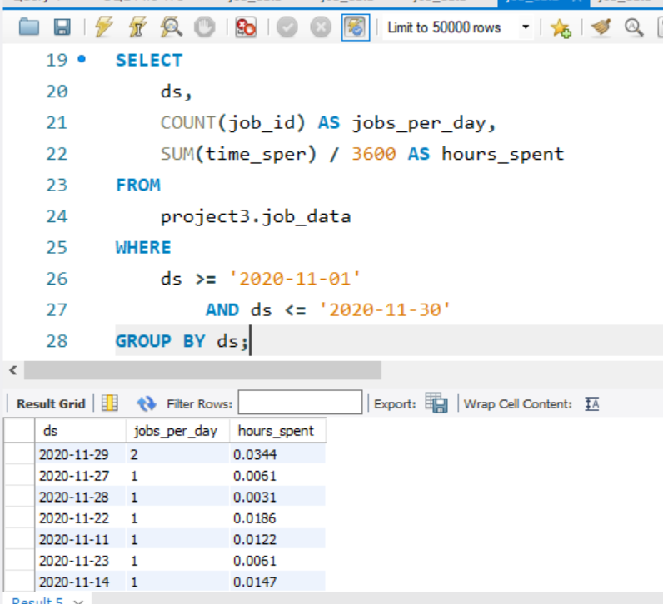
Case Study 1: Job Data Analysis
Task: Write an SQL query to calculate the number of jobs reviewed per hour for each day in November 2020.

Slide 7
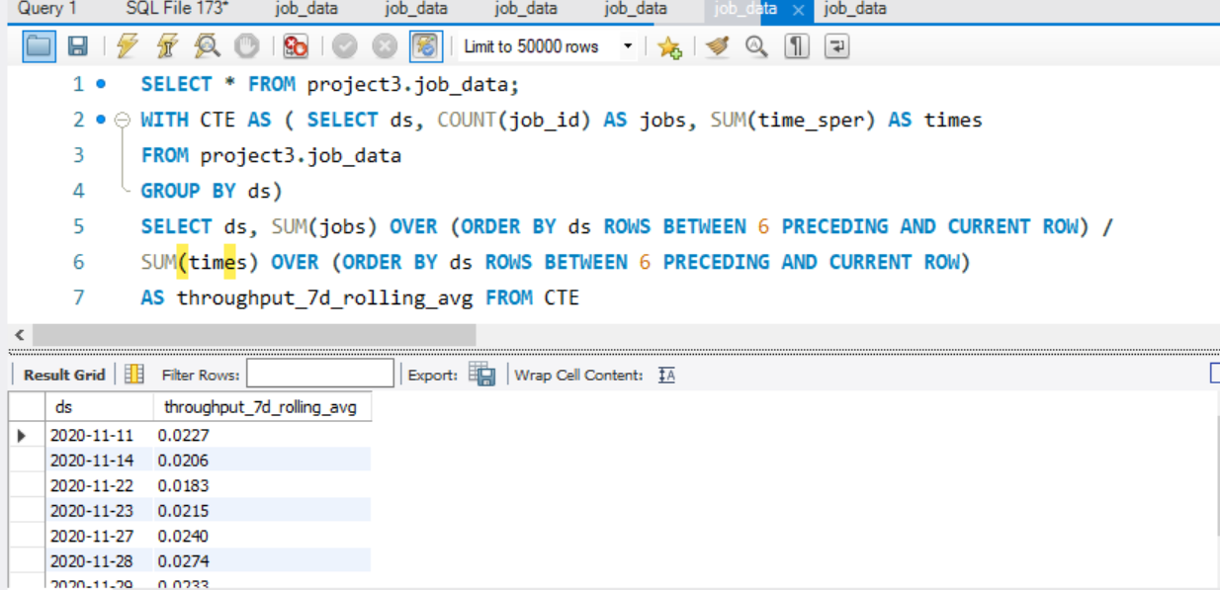
Case Study 1: Job Data Analysis
Task: Write an SQL query to calculate the 7-day rolling average of throughput. Additionally, explain whether you prefer using the daily metric or the 7-day rolling average for throughput, and why.

Slide 8
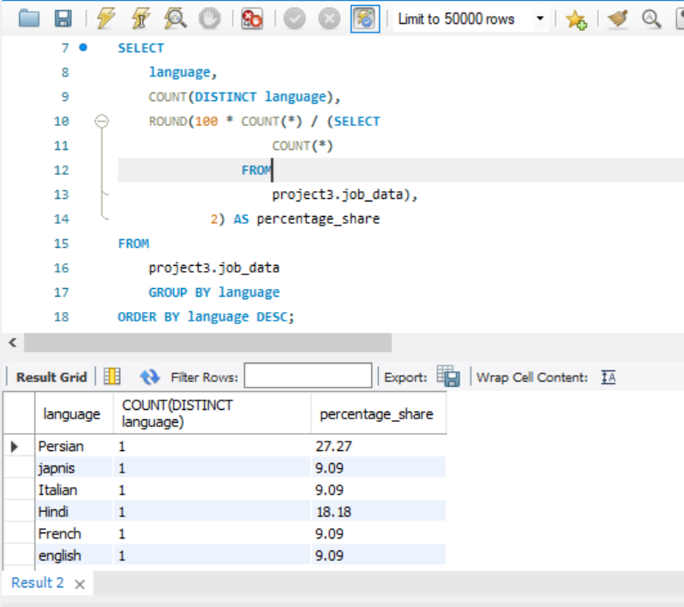
Case Study 1: Job Data Analysis
Task: Write an SQL query to calculate the percentage share of each language over the last 30 days.

Slide 9
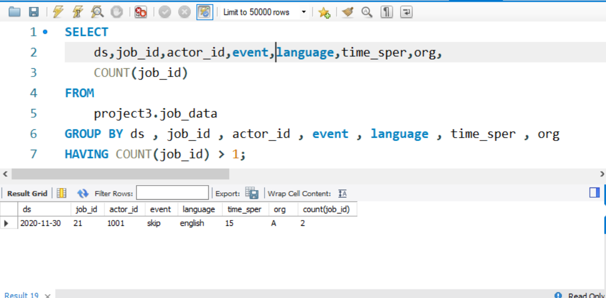
Case Study 1: Job Data Analysis
Task: Write an SQL query to display duplicate rows from the job_data table.

Slide 10
Case Study 2: Investigating Metric Spike

Slide 11
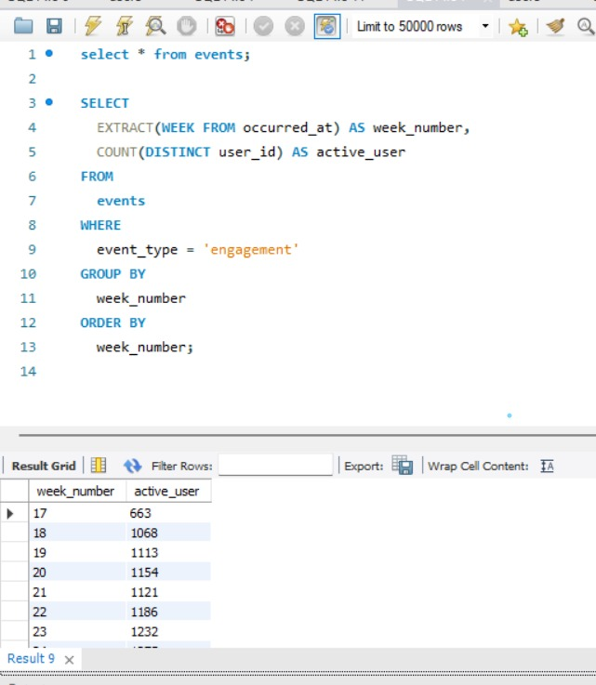
Case Study 2: Investigating Metric Spike
Weekly User Engagement
Task:
Write an SQL query to calculate the weekly user engagement.

Slide 12
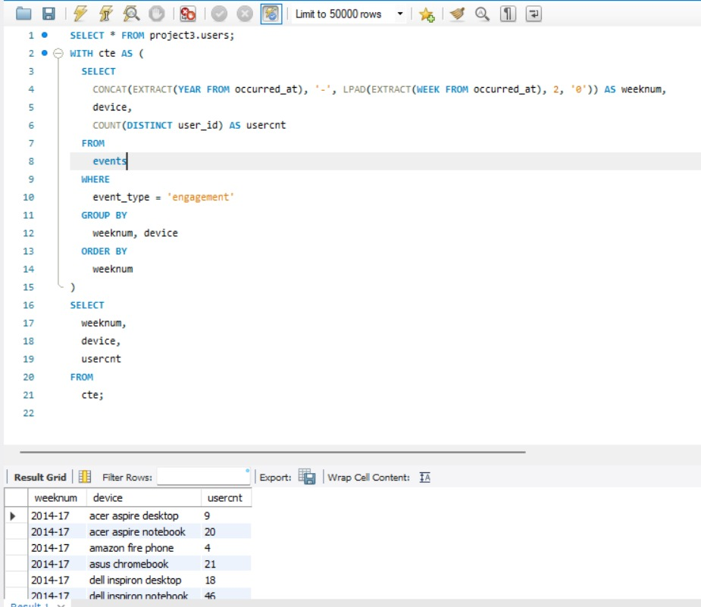
Case Study 2: Investigating Metric Spike
User Growth Analysis:
Task:
Write an SQL query to calculate the user growth for the product.

Slide 13
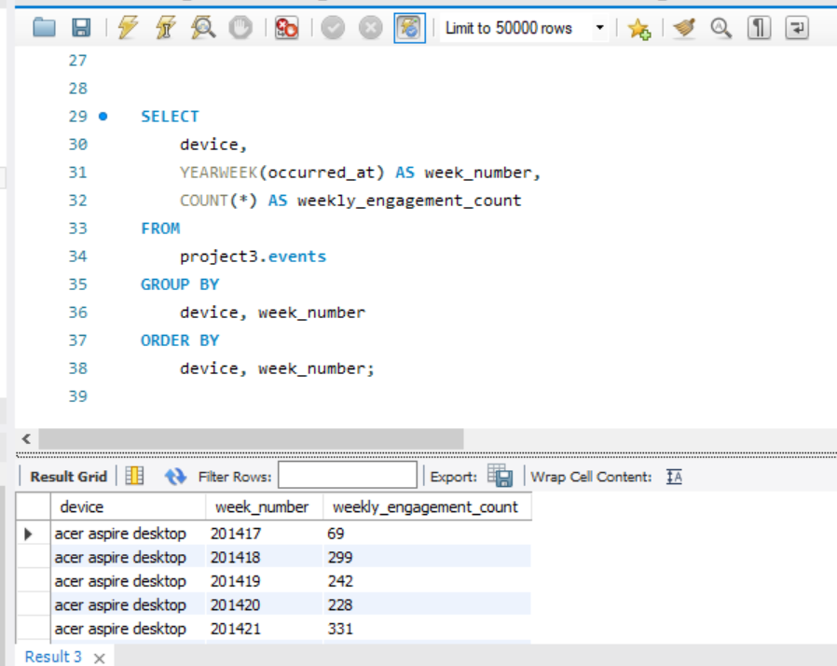
Case Study 2: Investigating Metric Spike
Weekly Engagement Per Device
Task:
Write an SQL query to calculate the weekly engagement per device..

Slide 14
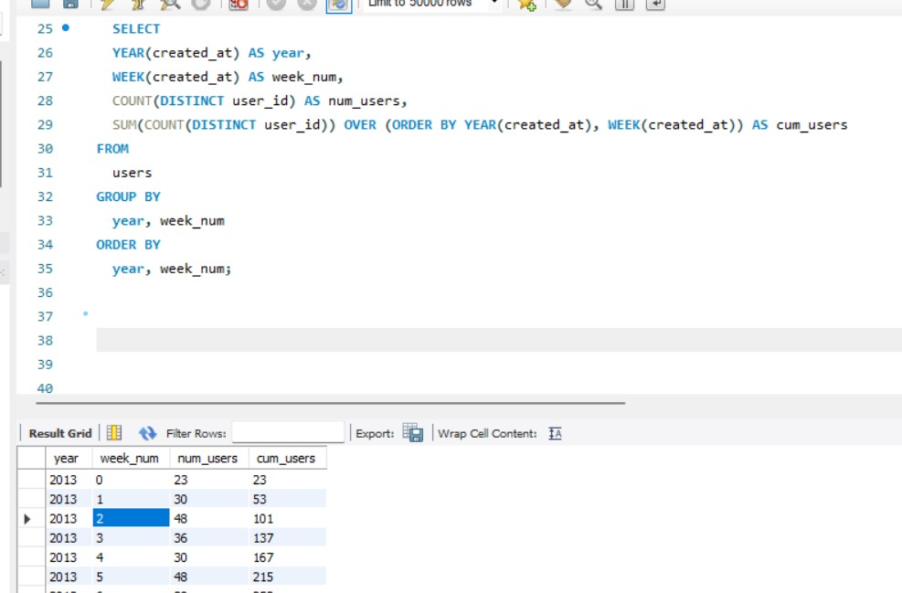
Case Study 2: Investigating Metric Spike
Weekly Retention Analysis:
Task:
Write an SQL query to calculate the weekly retention of users based on their sign-up cohort.

Slide 15
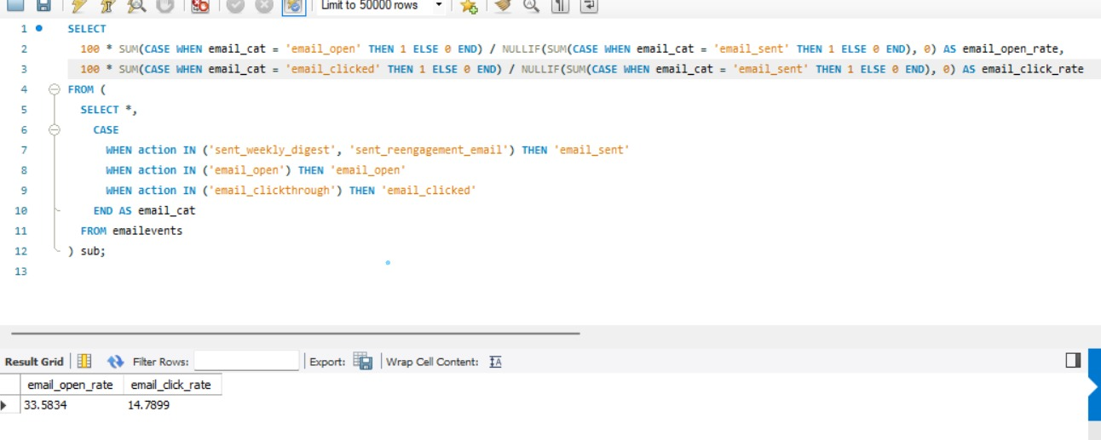
Case Study 2: Investigating Metric Spike
Email Engagement Analysis::
Task:
Write an SQL query to calculate the email engagement metrics..

Slide 16
Thank you
………………………………………..

